Slide 1



Proposal Document
Externship
Program
Project-Based Experiential Learning Program
SmartBridge | info@smartbridge.com

Slide 2














About SmartBridge
SmartBridge - Building Project-Ready Talent
SmartBridge is an ed-tech company founded in 2015, with a vision to build the job-ready talent pipeline for the emerging job markets across the globe.
Our edtech Platform: SmartInternz - Project-based learning & Virtual Internship Platform
Global Presence: India, Singapore
Collaborations
1Mn+
400K+
1000+
Students
Virtual Internships
Colleges
12+
25,000+
25+
Skilling Partnerships
Faculty Enabled
Hiring Partners

Slide 3













What is Externship Program ?
Externships usually occur during the academic year, as a part of a student's curriculum, and provide an experiential learning environment that offers real-world insight to theoretical topics being learned about in college.
Externships provide a unique opportunity for students to demonstrate what they've been learning in a real-world work environment, as well as a chance for the student to determine that the field they are interested in is a good fit.
Top Colleges Implementing Our Programs

Slide 4
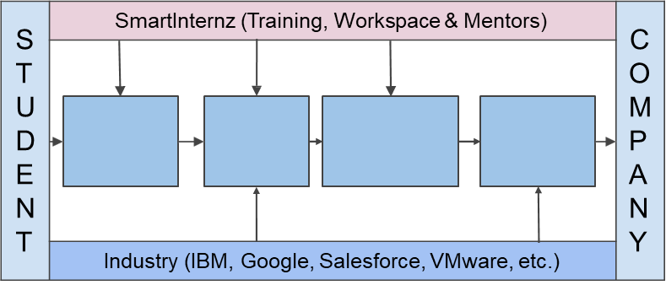
Externship Framework
Externship contains Project-based learning, hands-on bootcamps and real-world project experience. The externs will work on a project in teams under the supervision of experienced mentors in a company-like collaborative environment.
Externship framework is built based on the NACE recommendations for Career Readiness
Externship develops the professional & technical readiness competencies of the learner
Project-based learning provides hands-on exposure to the technology in a collaborative environment
Hands-on
Training
Guided
Projects
Certificate
& Score
Card
Assessment

Slide 5
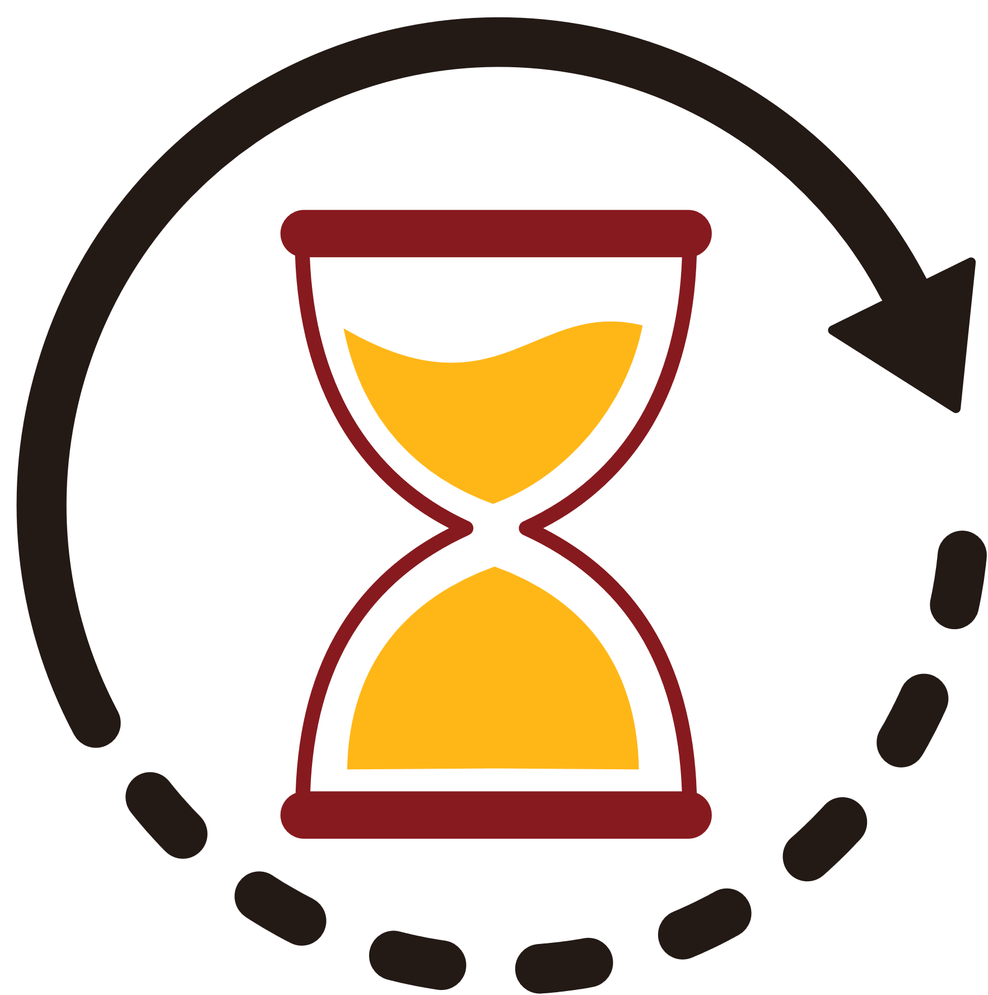











Highlights of Externship
Externship contains Project-based learning, hands-on bootcamps and real-world project experience. The externs will work on a project in teams under the supervision of experienced mentors in a company like collaborative environment.
Knowledge Sessions
(Additional Learning Modules)
Training & Development
80 Hrs.
Virtual Instructor-led Training
40 Hrs.
Brainstorming & Ideation
Project Development
40 Hrs.
(Choose a project from our catalog of 500+ projects.)
GitHub and Cloud Deployments
Requirement Analysis
Mentoring Support
Completion Certificates
Dedicated mentors assigned to teams
Externship Completion Certificate with Score Card
Mentor Support through
Chat Channels
Ask me Anything Sessions
On Demand 1 on 1 Interaction
Project Completion Certificate
Project Development
Project Design & Project Planning

Slide 6
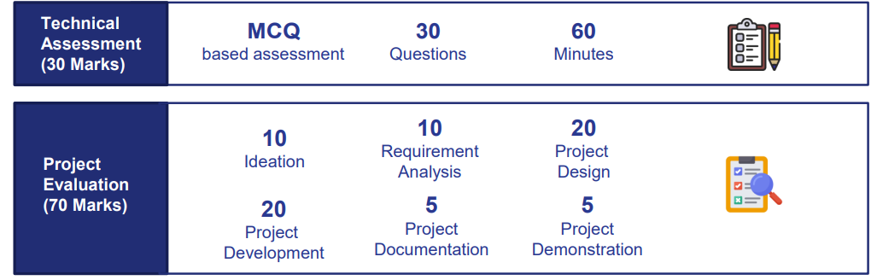
Assessment Rubrics
Total score for the program will be 100 marks and 30 marks of which would be the technical assessment score and
70 marks would be the project evaluation score as below.
Technical Evaluation of Students will be carried out in the form of a grand assessment at the end of technology
training sessions.

Slide 7
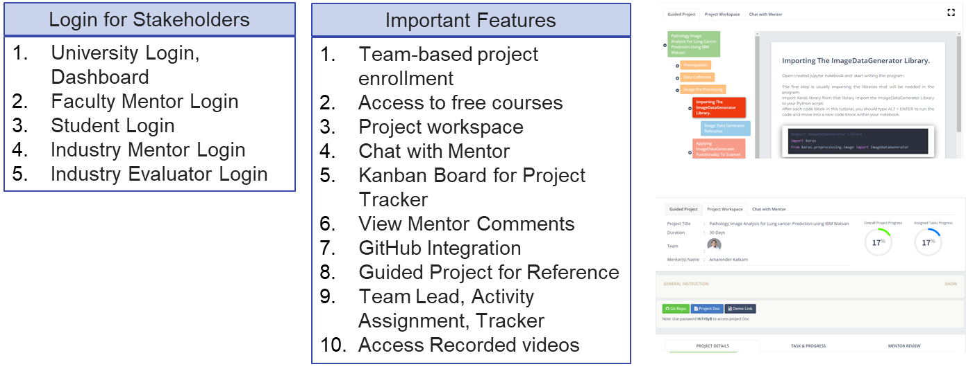
Platform Capability
Project-based learning platform has dedicated access to all the stack-holders involved in the project. It also provides a company like collaborative environment with a guided project template for student reference.

Slide 8











Program Execution Flow
Step 9
Certificate Distribution & Reports
Step 6
Project Development & Mentoring Sessions
Step 8
Project Evaluation
& Scoring
Step 5
Team-Based Project Enrollment
Step 7
Project Submission & Grand Assessment
Step 2
Onboarding on SmartInternz Platform
Step 4
Knowledge Sessions & Project Orientation
Step 1
Program Orientation Session
Step 3
Tech Training Sessions and Assignment & Quiz

Slide 9
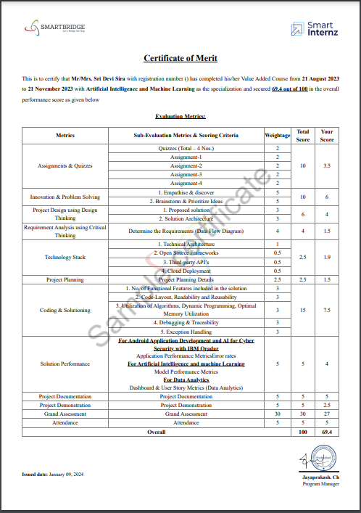
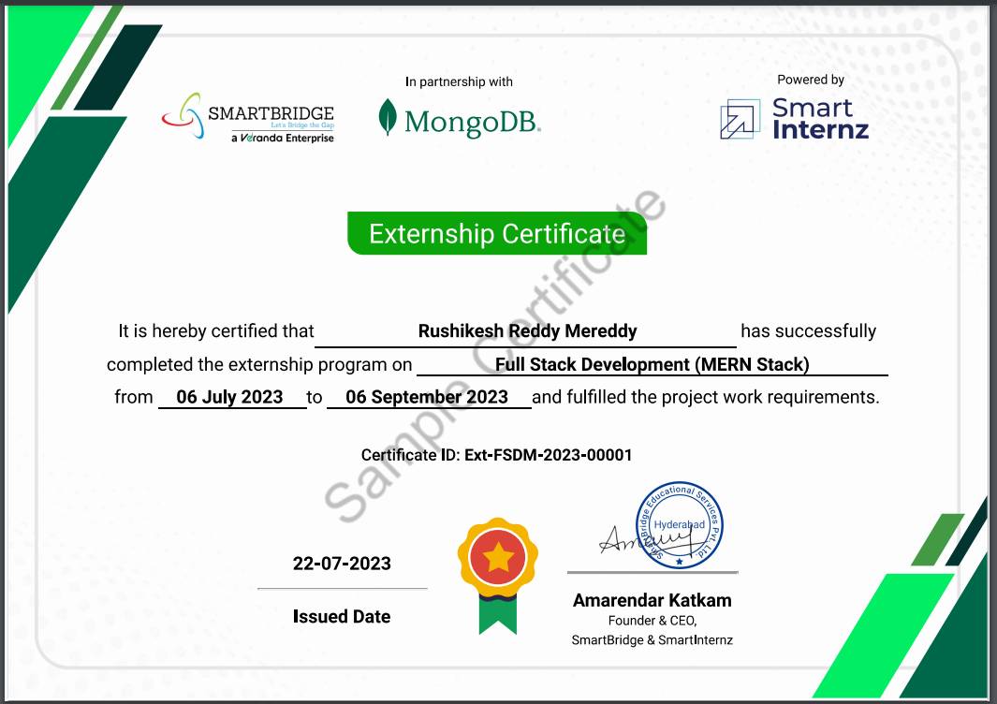
Sample Certificates
Merit Certificate

